Slide 1
Powershell for n00bs
Adam Mikolaj

Slide 2

About me
Database Administrator
Powershell enthusiast
Blog at sqlservercentral.com
www.sqlsandwiches.com
@sqlsandwiches
Adam@sqlsandwiches.com

Slide 3

Topic covered – power of the powershell
Starting out with Powershell
Basic commands
Building scripts
Useful scripts
Scheduling scripts

Slide 4

So what is Powershell?
PowerShell V1 dates back to 2006
Scripting language built on .NET Framework
Useful for automation and making your life easier.
Currently on V3
Console vs ISE (Integrated Scripting Environment)
http://blogs.msdn.com/b/powershell/archive/2009/04/17/differences-between-the-ise-and-powershell-console.aspx
Q: “Can I do XXX with Powershell?”
A: Pretty good chance of it

Slide 5

First things first – Execution Policy
Restricted – default. Script execution is disabled
AllSigned - must be Authenticode-signed before they will run
RemoteSigned - downloaded scripts from a remote location must be Authenticode-signed
Unrestricted – will run any script. FREEDOM!
Remember – It’s better to run AS ADMINISTRATOR
To find this, use the command:
Get-ExecutionPolicy
To set this, use the command
Set-ExecutionPolicy
Creating Certs for Powershell -
http://blogs.technet.com/b/heyscriptingguy/archive/2010/06/16/hey-scripting-guy-how-can-i-sign-windows-powershell-scripts-with-an-enterprise-windows-pki-part-1-of-2.aspx

Slide 6
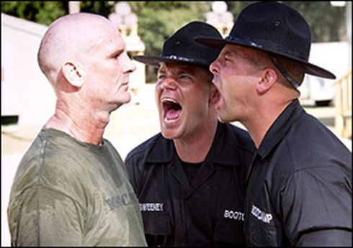
Basics of commands
Verb-noun
Get-ChildItem
Set-Variable
Clear-Content
Functions
Script Blocks
Pipes

Slide 7
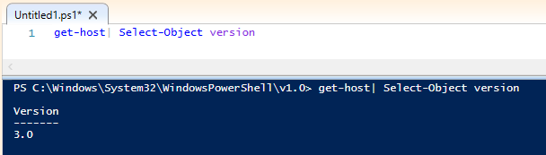
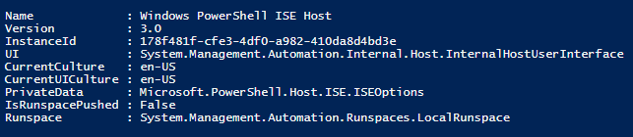
What version am I running?
get-host| Select-Object version
get-host| Select-Object * (or just get-host)
$psversiontable -

Slide 8

Some basic commands
Get-Help – ex: Get-Help -Name Get-ChildItem
Get-Content "C:\temp\servers.txt“
Get-ChildItem
ForEach-Object
Out-File
New-Object

Slide 9

Some Useful Commands
DEEEEEEEMOOOOOO!!!!

Slide 10
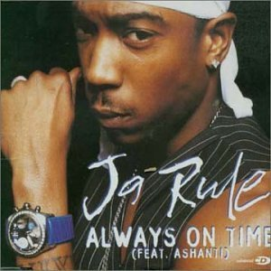
Schedule your job
SQL jobs - can use SQL agent
Task Scheduler

Slide 11
Resources
Powershell.com
Powershell.com’s Powertip of the day
Scripting Guy - http://blogs.technet.com/b/heyscriptingguy/

Slide 12


